Slide 1
COS 212 Stackless Traversals, Threading

Slide 2
Binary Search Tree ADT
A linked list that branches out from the root using left and right pointers
Binary Search Tree (BST):
all values in the left subtree must be smaller than the parent
all values in the right subtree must be larger than the parent
Every sub-tree (branch) is also a BST
Efficient search: O(lg n)
Traversal: breadth-first, depth-first
Depth-first, inorder: left->parent->right
5
3
7
protected void inorder(BSTNode<T> p)
{
if (p != null) {
inorder(p.left);
visit(p);
inorder(p.right);
}
}
1
6
9

Slide 3
Depth-first Traversal
Traversal algorithms are elegant. But are they efficient?
protected void preorder(BSTNode<T> p)
{
if (p != null) {
visit(p);
preorder(p.left);
preorder(p.right);
}
}
protected void inorder(BSTNode<T> p)
{
if (p != null) {
inorder(p.left);
visit(p);
inorder(p.right);
}
}
protected void postorder(BSTNode<T> p)
{
if (p != null) {
postorder(p.left);
postorder(p.right);
visit(p);
}
}

Slide 4
Postorder
protected void postorder(BSTNode<T> p)
{
if (p != null) {
postorder(p.left);
postorder(p.right);
visit(p);
}
}
5
3
7
Recursion is not magic – in case of computers, it’s just a stack
1
6
9
null
null
1
1
1
1
1
null
3
3
3
3
3
3
3
3
5
5
5
5
5
5
5
5
5
visit 1

Slide 5
Depth-first Traversal
What if we re-write recursive functions iteratively?
protected void preorder(BSTNode<T> p)
{
if (p != null) {
visit(p);
preorder(p.left);
preorder(p.right);
}
}
Now we’re just using a stack manually!
Is non-recursive implementation better?
protected void preorder()
{
BSTNode<T> p = root;
Stack<BSTNode<T>> stack = new Stack<BSTNode<T>>();
if (p != null) {
stack.push(p);
while(!stack.isEmpty()) {
p = stack.pop();
visit(p);
if(p.right != null) stack.push(p.right);
if(p.left != null) stack.push(p.left);
}
}

Slide 6
Depth-first Traversal
protected void postorder(BSTNode<T> p)
{
if (p != null) {
postorder(p.left);
postorder(p.right);
visit(p);
}
}
Which one do you prefer?
protected void postorder() {
BSTNode<T> p = root, q = root;
Stack<BSTNode<T>> stack = new Stack<BSTNode<T>>();
while (p != null) {
for(;p.left != null; p = p.left) stack.push(p);
while(p != null && (p.right == null || p.right == q)) {
visit(p);
q = p;
if(stack.isEmpty()) return;
p = stack.pop();
}
stack.push(p);
p = p.right;
}
}

Slide 7
Depth-first Traversal
Welcome to the iterative HELL!
protected void inorder(BSTNode<T> p)
{
if (p != null) {
inorder(p.left);
visit(p);
inorder(p.right);
}
}
Elegance is gone, but NO improvement is achieved ☹
protected void inorder() {
BSTNode<T> p = root;
Stack<BSTNode<T>> stack = new Stack<BSTNode<T>>();
while (p != null) {
while(p != null) {
if(p.right != null) stack.push(p.right);
stack.push(p);
p = p.left;
}
p = stack.pop();
while(p.right == null && !stack.isEmpty()) {
visit(p);
p = stack.pop();
}
visit(p);
if(!stack.isEmpty()) p = stack.pop();
else p = null;
}
}

Slide 8
Stackless Depth-First Traversals?
Both recursive and iterative traversal algorithms use a stack: either implicitly (recursion) or explicitly (iteration)
Possible problems?
Potential stack overflow
Overhead of using an additional data structure
Why do we use a stack: to backtrack
What if we made the tree doubly-linked instead?
I.e., every node knows its parent
Efficiency?
Paths will have to be travelled twice: from root to leaf and all the way back
Extra memory is needed to store the “parent” references
Compromise: Threaded Binary Tree
5
3
7
1
6
9

Slide 9
Threaded Binary Tree
Most useful traversal of a binary search tree: inorder
We only wish to visit every node once
Instead of storing a “parent” reference, store a reference to the next node according to inorder traversal
Save memory: instead of adding extra reference variables, re-use “left” and “right” references
If left pointer is NULL, make it point to the in-order predecessor
If right pointer is NULL, make it point to the in-order successor
These references are called “threads”
Single-threaded tree: only the right pointers are re-used
Double-threaded tree: both left and right pointers are re-used

Slide 10
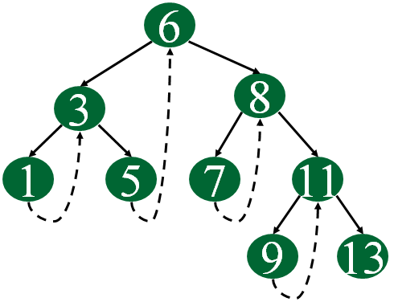
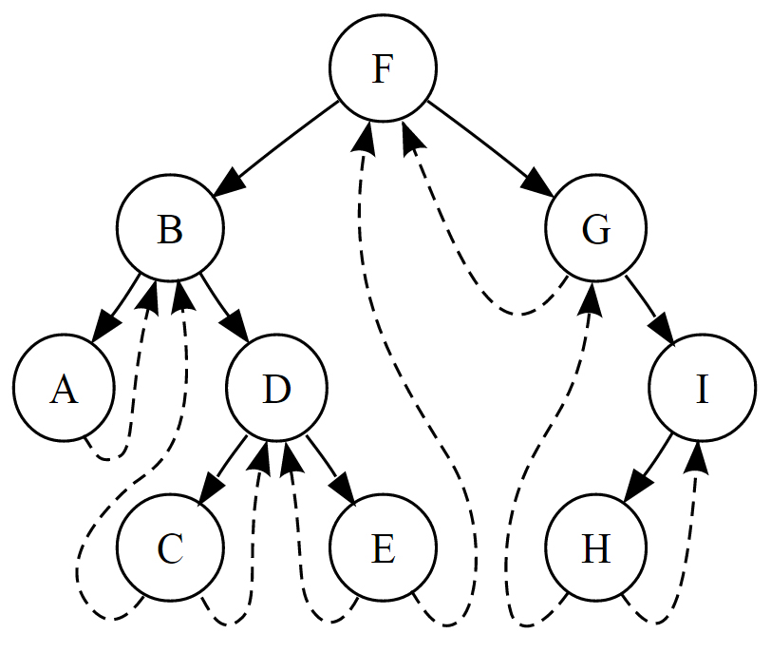
Threaded Binary Tree
Single-threaded
Double-threaded

Slide 11
Threaded Binary Tree
public class BSTNode<T extends Comparable<? super T>> {
protected T el;
protected BSTNode<T> left, right;
protected boolean hasThread;
// constructors
}
Refer to page 228 for explanation
el
hasThread flag indicates whether the right pointer is a thread

Slide 12
Threaded Binary Tree
Traversing a threaded BST inorder:
Start at the root
Proceed to the leftmost node
While current node p != NULL:
Visit current node
If the right pointer points to a child, set p = leftmost child of right
Else, if right pointer points to a successor, set p = right

Slide 13
Traversal Through Transformation
Ordinary BSTs use an implicit or an explicit stack for traversals
Threaded BSTs do not use a stack, but incorporate “stack order” in the tree itself by maintaining threads
Can we somehow traverse a BST without a stack and without threads?
Consider the tree on the right:
For an in-order traversal:
Set p = root
While p != null:
Visit p
Set p = p.right
Joseph M. Morris devised an algorithm to linearize any BST, traverse it, and then put it back together
A
D
E
F
Z

Slide 14
Traversal Through Transformation
Problem?
Initialize p as root
While p is not NULL
If p does not have left child:
Visit p
Go to the right, i.e., p = p.right
Else
Make p the right child of the rightmost node in p's left subtree
Go to the left child of p, i.e., p = p->left
tmp
p
tmp
tmp
p
A
A
p
A
tmp
D
D
D
D
p
A
E
E
E
E

Slide 15
Reversible Morris Traversal
p
Initialize p as root
While p is not NULL
If p does not have left child:
Visit p
Go to the right, i.e., p = p.right
Else
Set tmp = p.left, and keep going right until tmp.right == null OR tmp.right == p
If tmp.right == null:
Make p the right child of tmp
Go to the left child of p, i.e., p = p->left
Else (if tmp.right == p)
Visit p
Unlink tmp.right, i.e. tmp.right = null
Go to the right, i.e., p = p.right
tmp
D
A
E
p
A
tmp
D
A
p
E
tmp
D
tmp
D
p
E
A
E

Slide 16
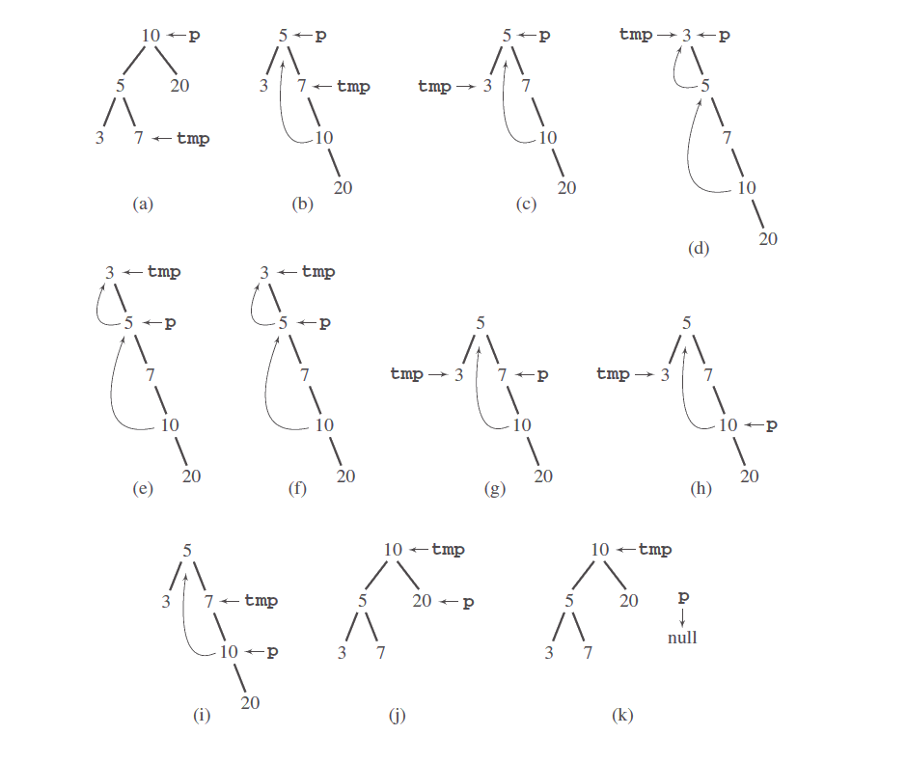
Morris Tree Traversal

